Slide 1

Optimizing Energy Consumption through Deep Learning Models: A Sustainable AI Approach

Slide 2



Introduction to Energy Optimization
is crucial for sustainability. This presentation explores how
can enhance energy efﬁciency. By leveraging advanced AI techniques, we can signiﬁcantly reduce waste and promote a more sustainable future. Join us as we delve
into the intersection of technology and environmental responsibility.

Slide 3
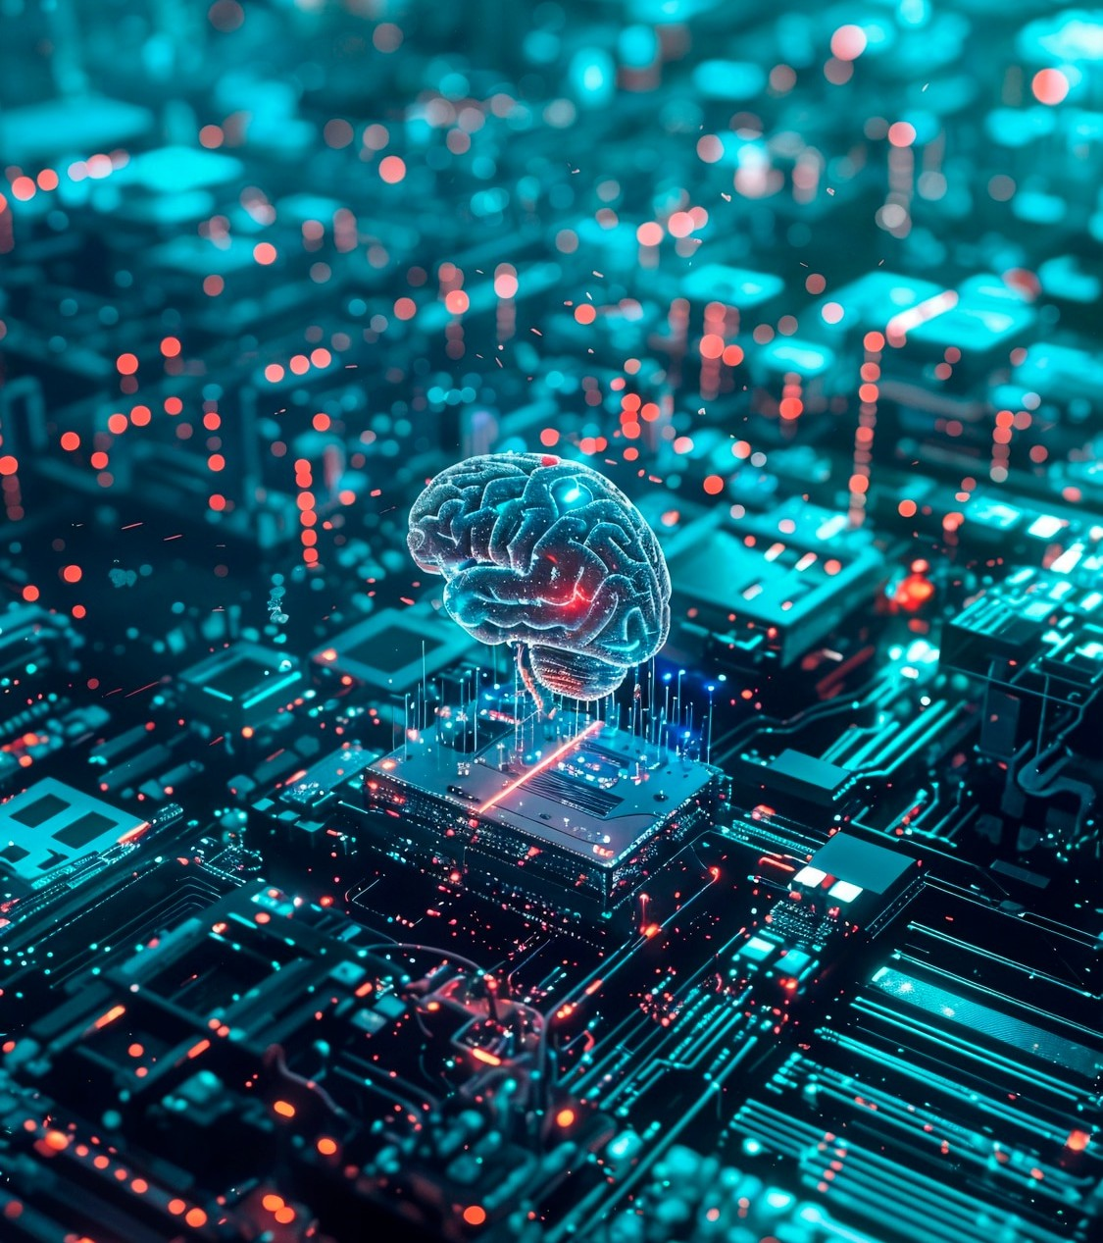

Understanding Deep
Learning
is a subset of machine learning that uses neural networks to analyze vast amounts of data. By recognizing patterns, these models can make informed predictions. This capability is essential for optimizing energy consumption, as it allows us to identify inefﬁciencies and propose
solutions effectively.

Slide 4
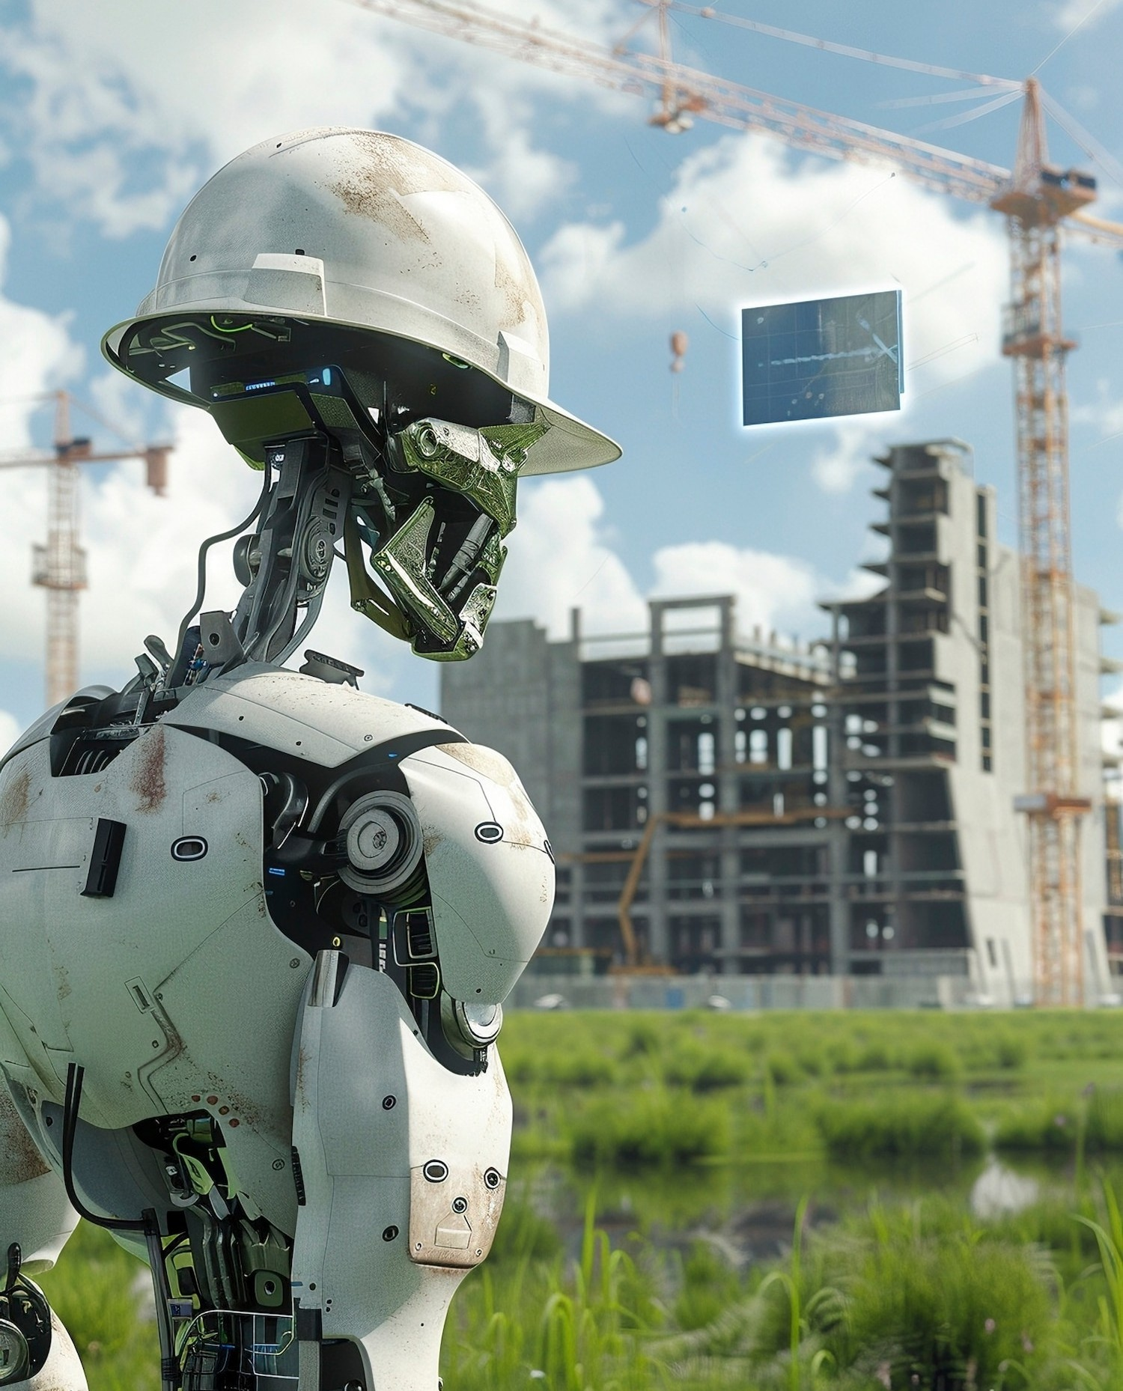


Applications in Energy Sector
Deep learning models are applied in
various areas of the including
,
, demand
forecasting, and predictive maintenance. These applications help utilities optimize their resources, reduce operational costs, and improve service reliability, ultimately leading to more sustainable energy practices.

Slide 5
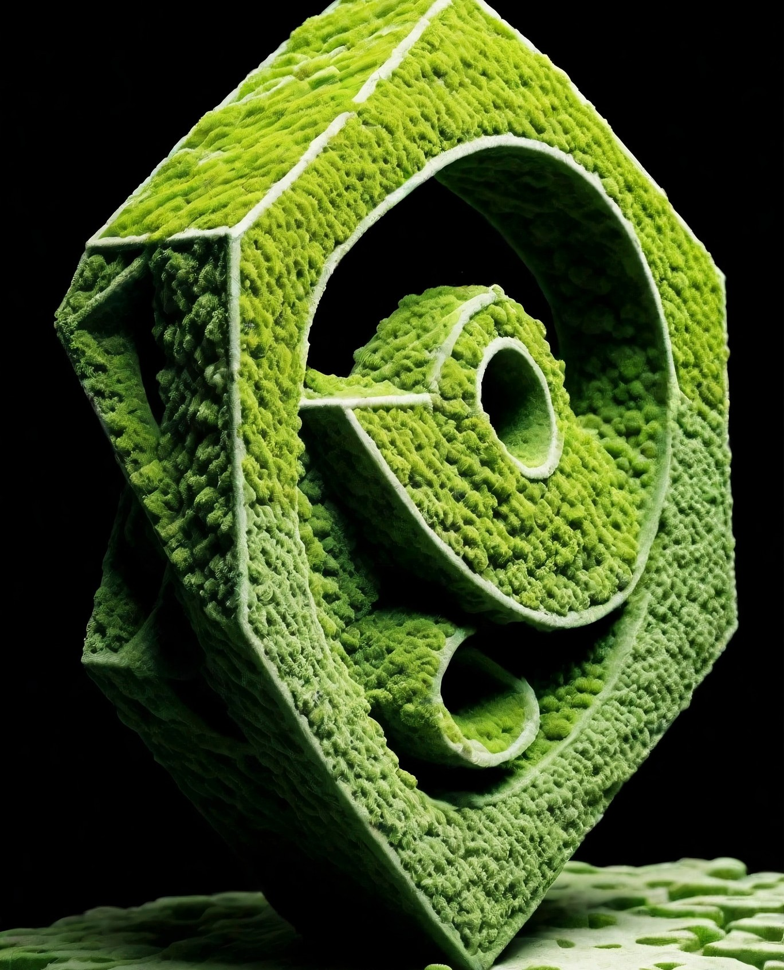

Case Studies and Success Stories
Several organizations have successfully implemented deep learning solutions for energy optimization. For instance, utilize AI to balance supply and
demand efﬁciently. These case studies demonstrate the potential of AI-driven strategies to reduce energy
consumption and enhance sustainability across various industries.

Slide 6



Challenges and Considerations
While deep learning presents numerous beneﬁts, there are challenges to consider, such as
, model interpretability, and ethical implications. Addressing these challenges is vital for ensuring that AI solutions are not only effective but also responsible and equitable in their
application.

Slide 7
Conclusion and Future Outlook
In conclusion, optimizing energy consumption through deep learning models represents a . As technology advances, the potential for AI to drive energy efﬁciency will only increase. Embracing these innovations is essential for a sustainable future, balancing technological progress with environmental stewardship.

Slide 8
Thank you
Done by
Koushik Vishal S
RA2211026010384
Pritish Gulati
RA2211026010370

